Slide 1
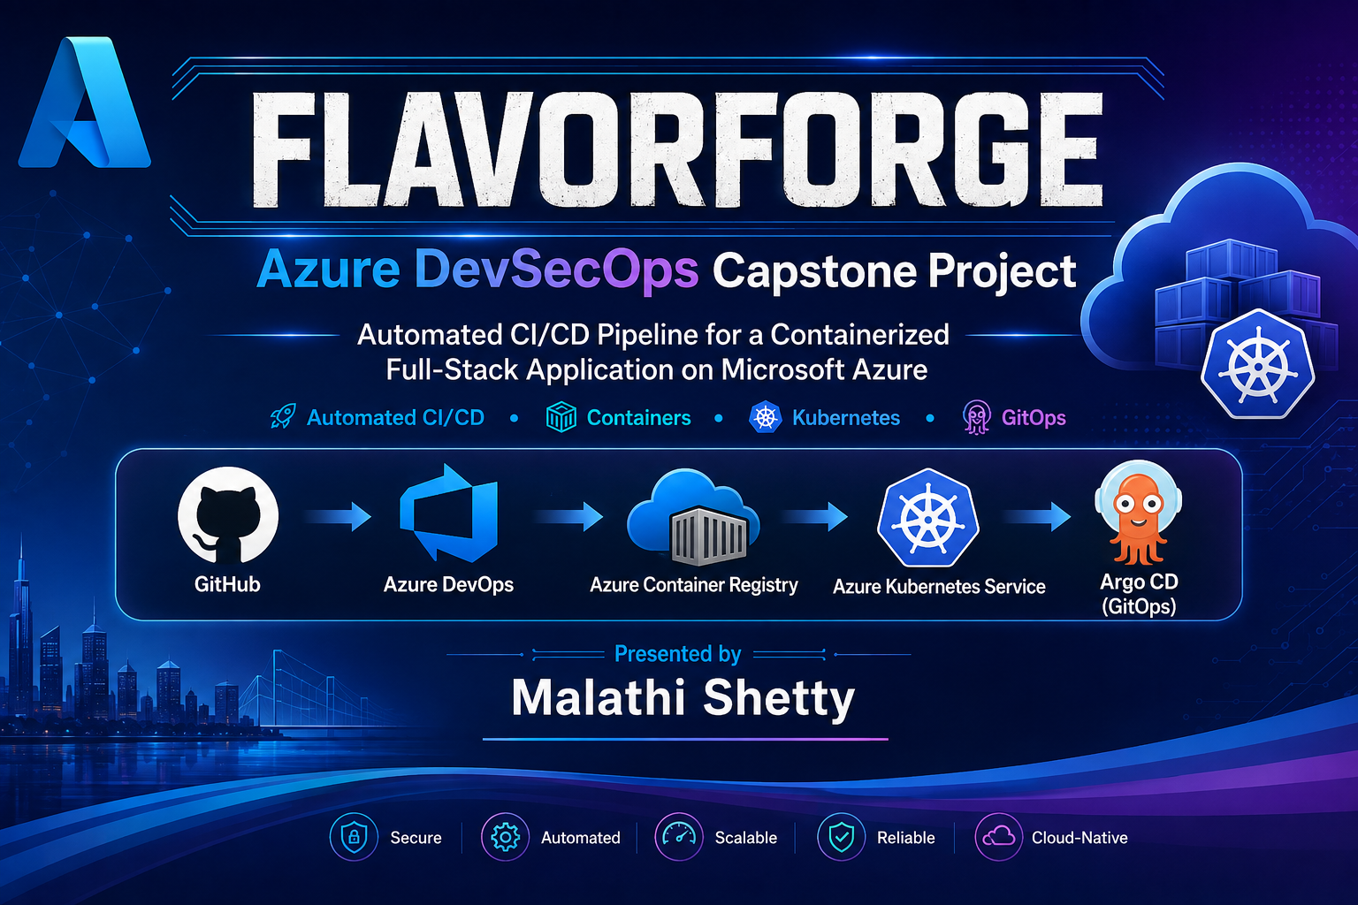

Slide 2

About Me
Professional Background
13+ years of Software Testing experience
Manual, Automation (Selenium) & API Testing
Experience working in Agile development environments
DevOps Journey
Transitioning into Cloud & DevOps
Hands-on experience with Azure DevOps, Docker, Kubernetes, Terraform, GitHub Actions & Argo CD
Built the FlavorForge Azure DevSecOps Capstone Project

Slide 3
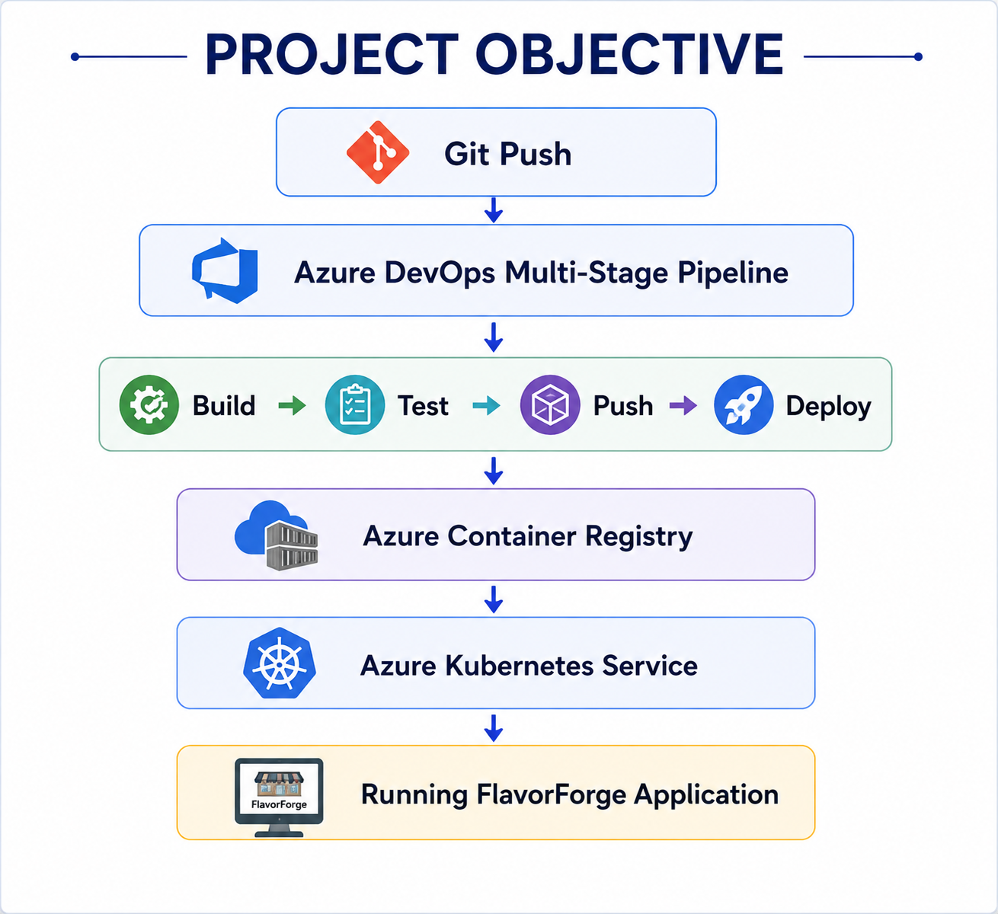
Project Objective
Project Objective
• Design an end-to-end Azure DevSecOps pipeline
• Automate Build → Test → Push → Deploy
• Deploy a containerized application to AKS
• Integrate DevSecOps and GitOps practices

Slide 4
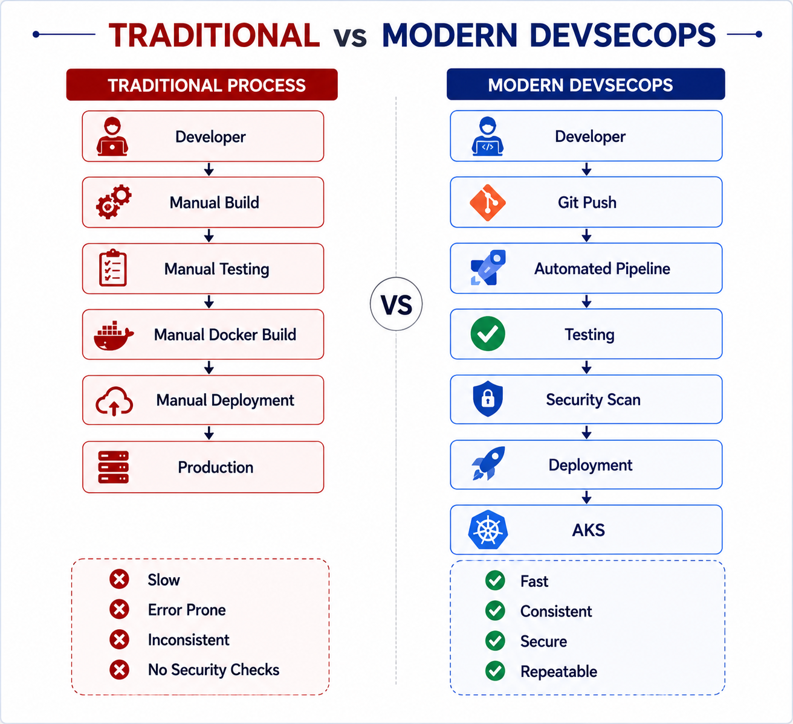
Project Objective
Problem Statement
• Manual deployments are time-consuming and error-prone.
• Quality and security checks are often inconsistent.
• Deployments lack repeatability and scalability.
• Modern applications require automated, secure, and reliable delivery.

Slide 5
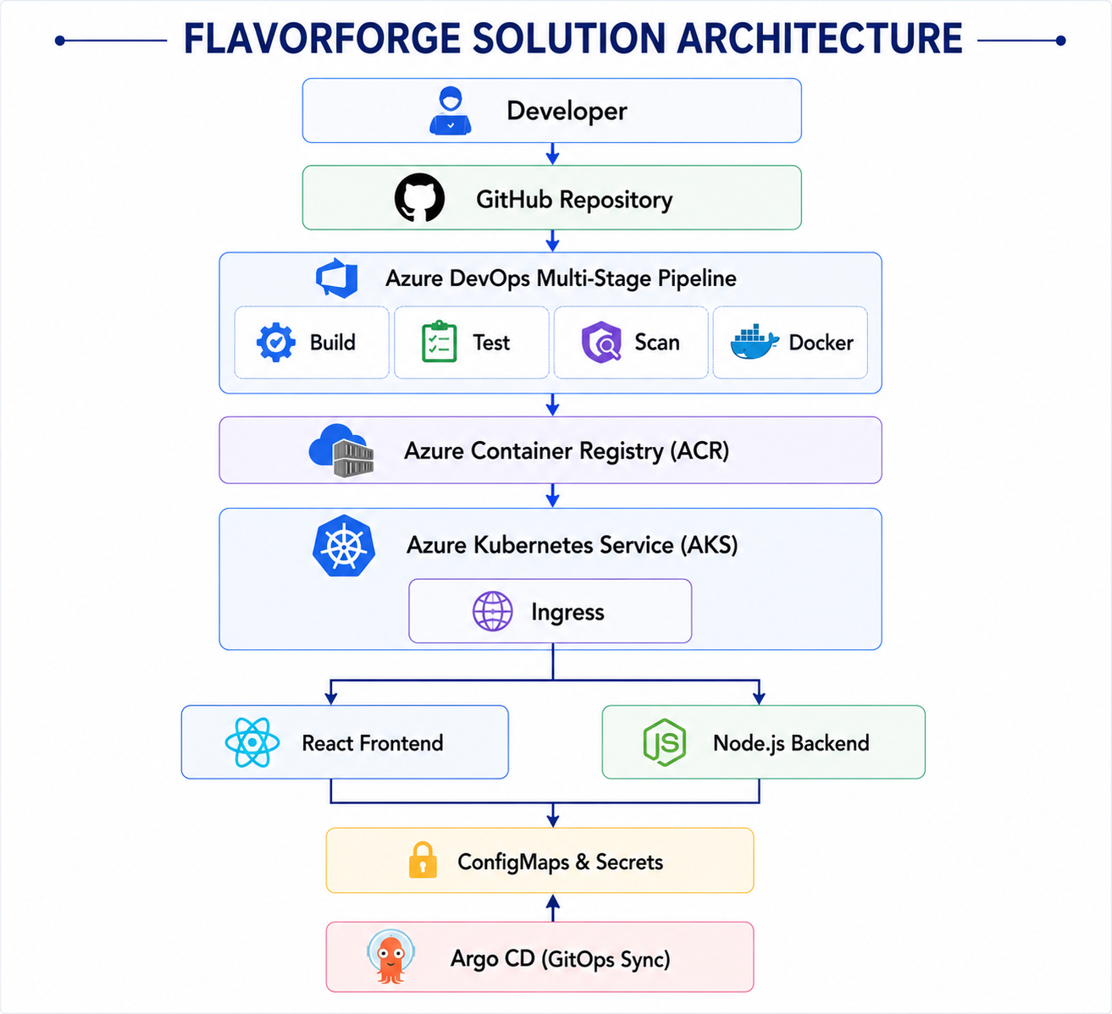
Solution Architecture
End-to-End Azure DevSecOps Pipeline for Automated Application Delivery

Slide 6
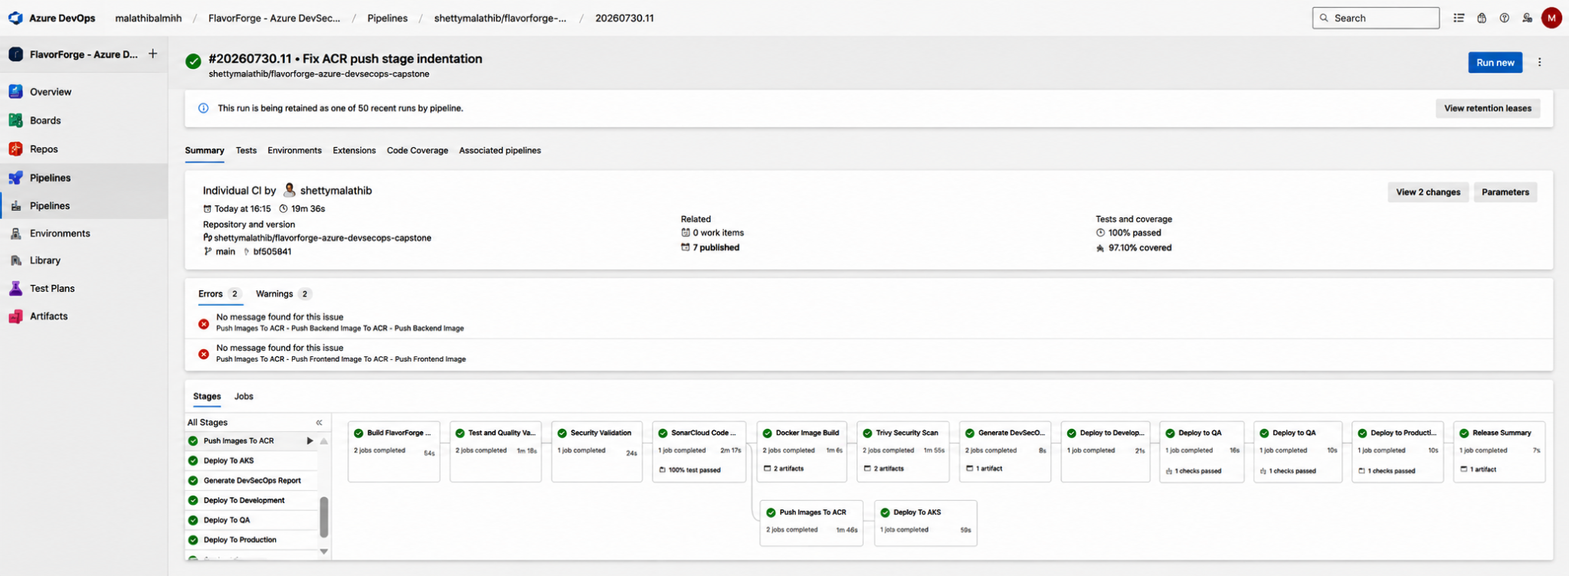
Enterprise Multi-Stage Azure DevOps Pipeline
Single Git push triggers the complete pipeline
Automated Build, Test, Security Scan & Containerization
Multi-environment deployment: Dev → QA → Production
Controlled releases with environment approvals
Docker images published to Azure Container Registry (ACR)
Automated deployment to Azure Kubernetes Service (AKS)

Slide 7
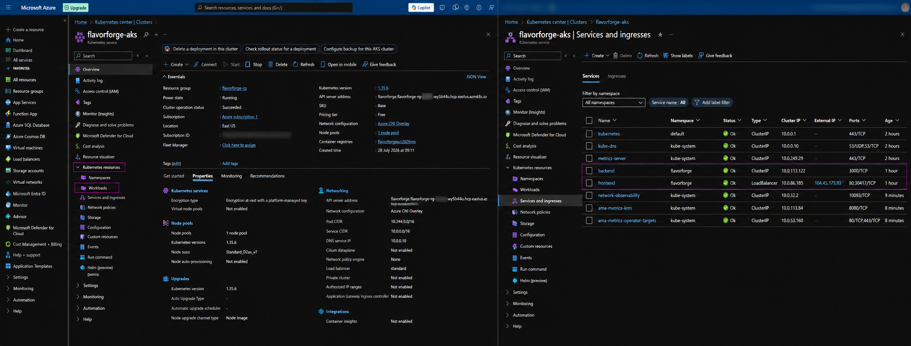
Azure Kubernetes Service (AKS) Deployment
Containerized application deployed to AKS
Frontend and Backend deployed as separate workloads
Services exposed through Ingress
Scalable and highly available deployment

Slide 8
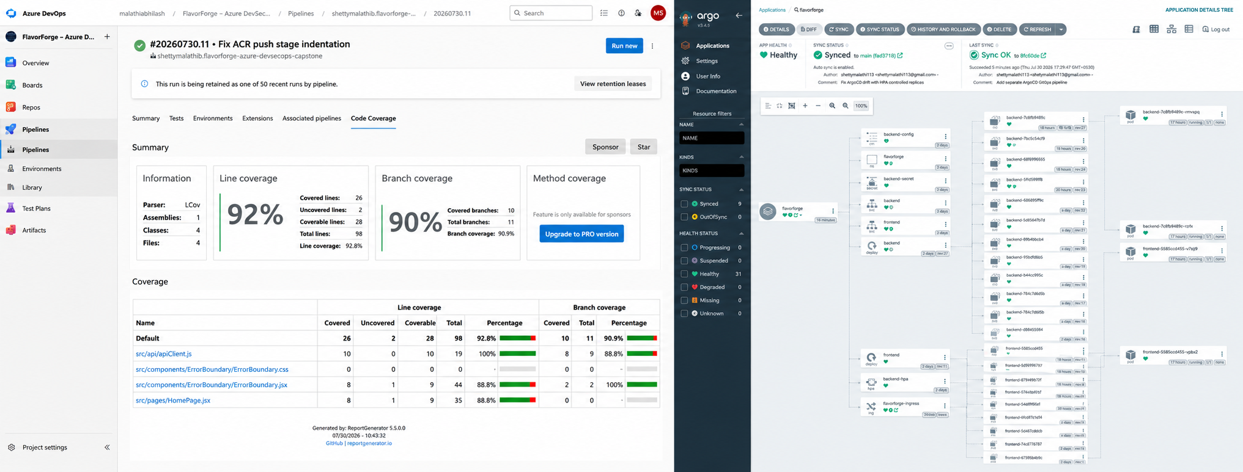
Security & GitOps
Code quality validated using SonarCloud
Container images scanned with Trivy
Continuous deployment managed using Argo CD
Git repository acts as the single source of truth

Slide 9
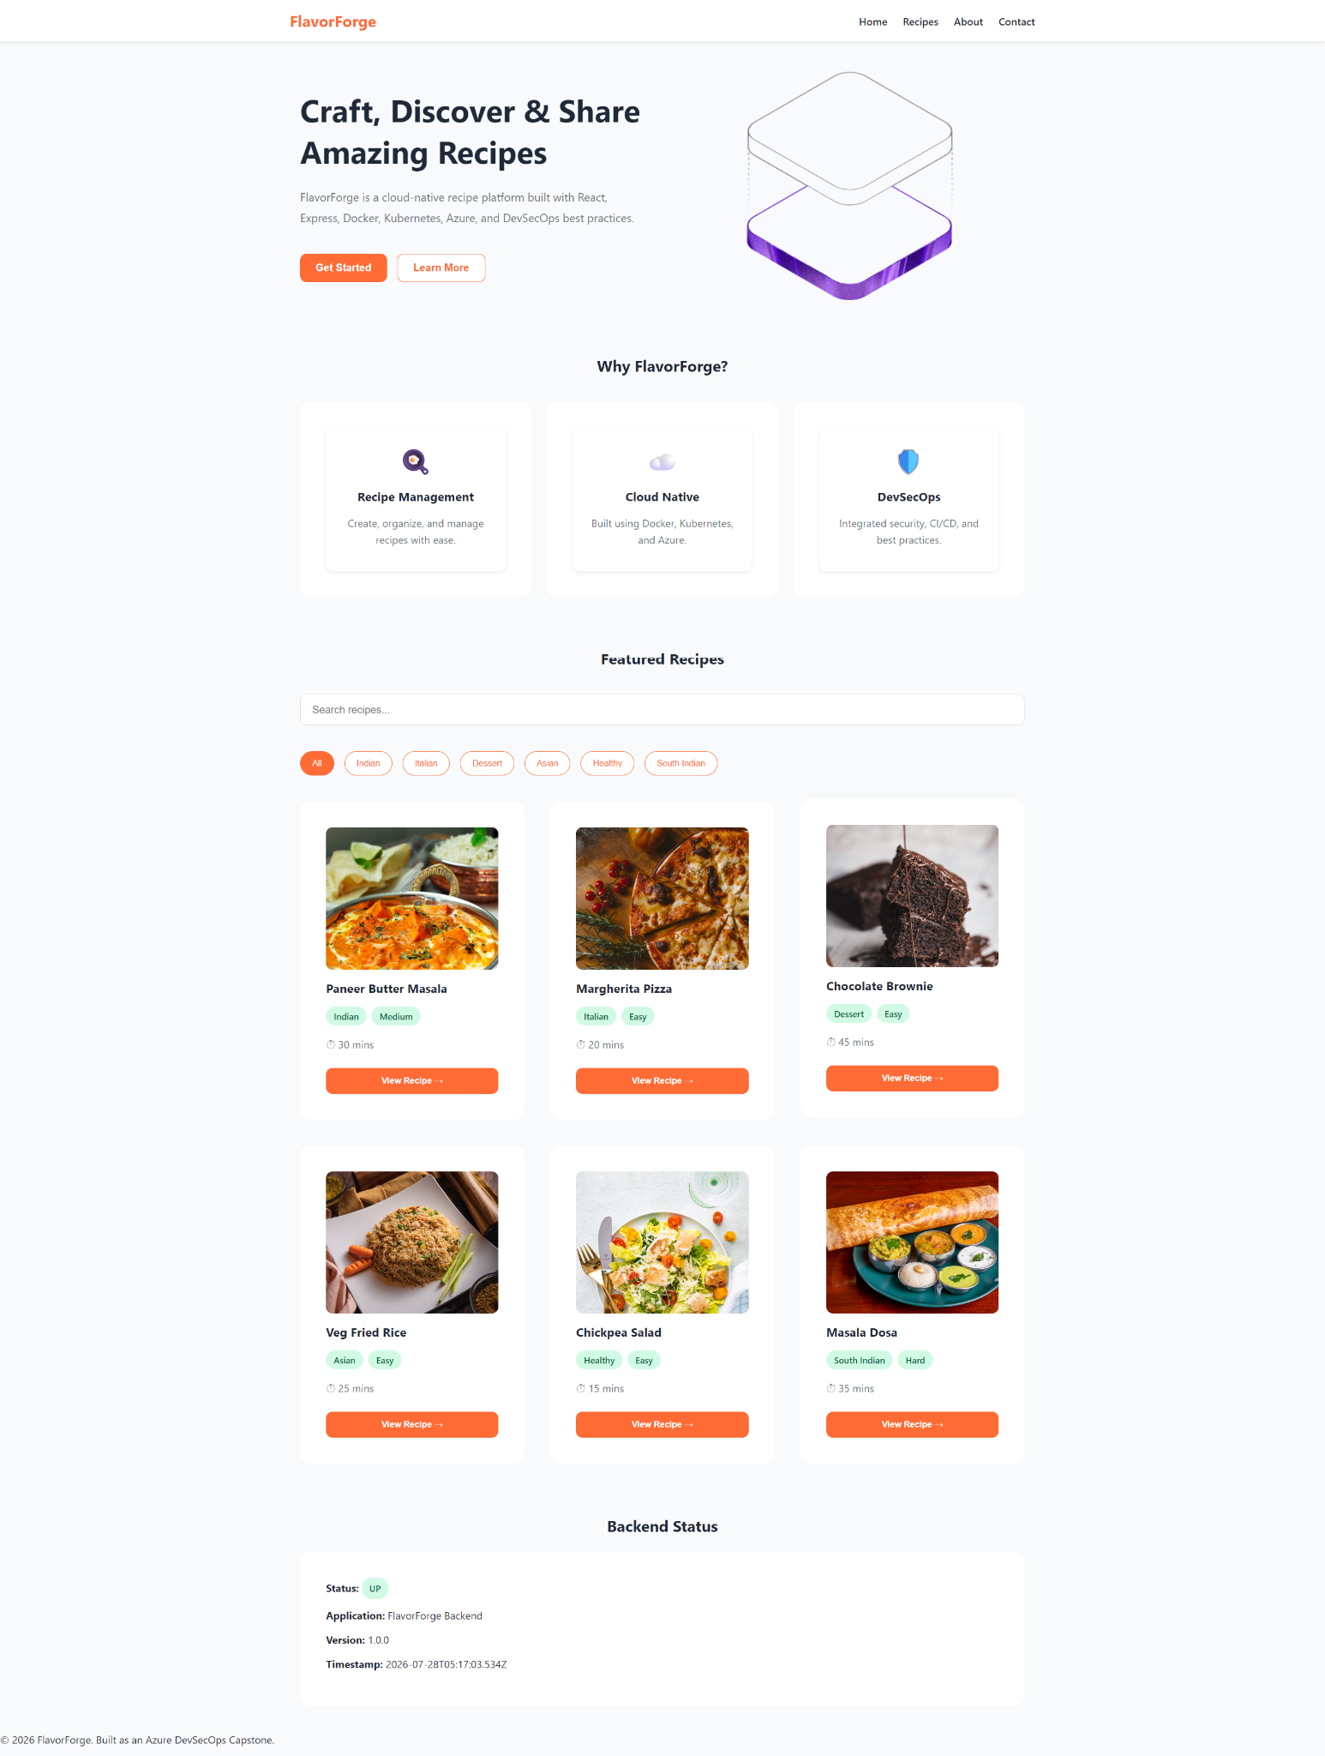
Project Results
Successfully deployed on Azure Kubernetes Service
End-to-end Azure DevSecOps pipeline implemented
Enterprise-style Dev → QA → Production release workflow
Integrated DevSecOps, GitOps, and automated security checks
Production-ready cloud-native deployment demonstrated

Slide 10
